Slide 1
Python programming
unit 1a – program flow control

Slide 2
Flow chart
START
END
Terminator points
Data input/output
Process / function
?
Yes
Decision
Flow line
No

Slide 3
Conditional Flow control
if condition :
block1 of code
…
else:
block2 of code
…
1
if condition :
block of code
…
2
START
START
condition?
Yes
condition?
Yes
No
block
No
block2
block1
END
END

Slide 4



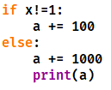
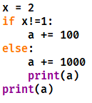
In class practice: what is the result for those code?
①
①
①
②
②
②
③
③
③
④
①
①
②
②
③
③
④
④
⑤
⑤
⑥
⑦

Slide 5
if condition1 :
block1 of code
…
elif condition2 :
block2 of code
…
else:
block3 of code
…
START
Yes
3
condition1?
No
block1
Yes
condition2?
No
block2
Can have more elif when need
But only one else is allowed
block3
END

Slide 6
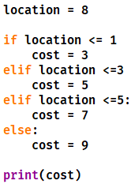
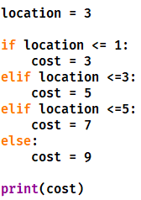
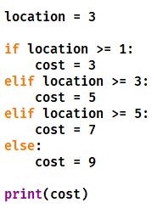
In class practice: 1. anything wrong? what is the result for those code? 2. give correct execution flow order of line number which has no error.
①
①
①
②
②
②
③
③
③
④
④
④
⑤
⑤
⑤
⑥
⑥
⑥
⑦
⑦
⑦
⑧
⑧
⑧
⑨
⑨
⑨
⑩
⑩
⑩

Slide 7
for loop Flow control
START
No
Have next item?
1
for variable in iterable :
block of code
…
Yes
Take one put to variable
Loop block
for variable in iterable :
block of code
…
else:
block of code
…
2
Else block
END
If need only one else is allowed

Slide 8

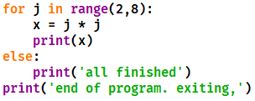
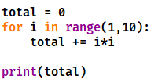
In class practice: 1. anything wrong? what is the result for those code? 2. give correct execution flow order of line number which has no error.
①
①
②
②
③
④
⑤
⑥
①
②
③
④

Slide 9
while loop Flow control
START
No
Loop condition?
1
while condition :
block of code
…
Yes
while condition :
block of code
…
else:
block of code
…
Loop block
2
Else block
END
If need only one else is allowed

Slide 10
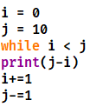
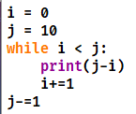
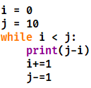
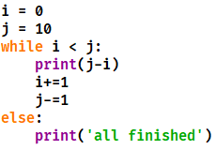
In class practice: 1. anything wrong? what is the result for those code? 2. give correct execution flow order of line number which has no error.
①
①
①
②
②
②
③
③
③
④
④
④
⑤
⑤
⑤
⑥
⑥
⑥
①
②
③
④
⑤
⑥
⑦
⑧

Slide 11
break statements
No
Loop judgement?
Yes
for or while loop :
block1 of code
…
if condition:
break
block2 of code
…
Loop block1
Yes
test?
No
Loop block2
Else block

Slide 12
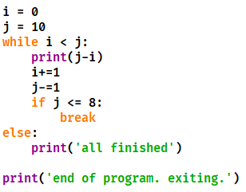
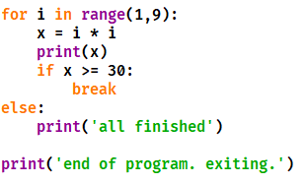
In class practice: 1. give correct execution flow order of line number. 2. what is the result for those code?
①
①
②
②
③
③
④
④
⑤
⑤
⑥
⑥
⑦
⑦
⑧
⑨
⑧
⑩
⑪

Slide 13
continue statements
No
Loop judgement?
for or while loop :
block1 of code
…
if condition:
continue
block2 of code
…
Yes
Loop block1
Yes
test?
No
Loop block2
Else block

Slide 14
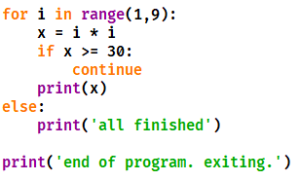
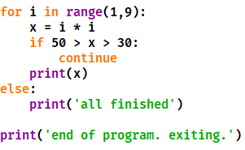
In class practice: 1. give correct execution flow order of line number. 2. what is the result for those code?
①
①
②
②
③
③
④
④
⑤
⑤
⑥
⑥
⑦
⑦
⑧
⑧

